Slide 1
Proteogenomic characterization of immortalized jejunal fibroblast cell lines with different telomere maintenance mechanisms
Key points:
Immortal cell lines with different TMMs established from the same origin
Similar levels of genome mutation and rearrangement posed in ALT/TEL cell groups
Loss of ATRX as a universal feature in JFCF-6 ALT cells
Loss of 7q as significant features in JFCF-6 ALT cells
Positive associations of CNA on 7q,10q and 20q with gene expressions
Quantitative proteomics present distinctions between parental, ALT and TEL cell lines
Proteogenomic model of immortalization process in JFCF-6 cells
Identification of novel TM signatures

Slide 2
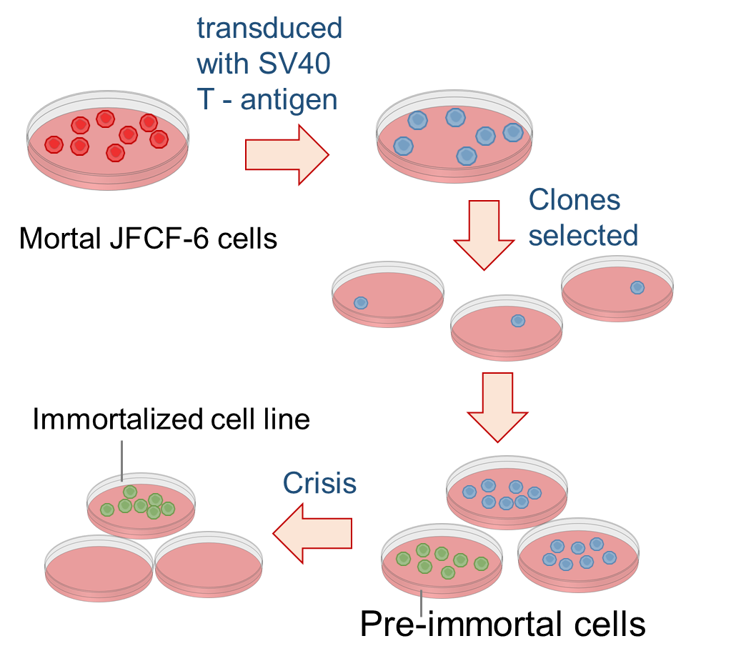
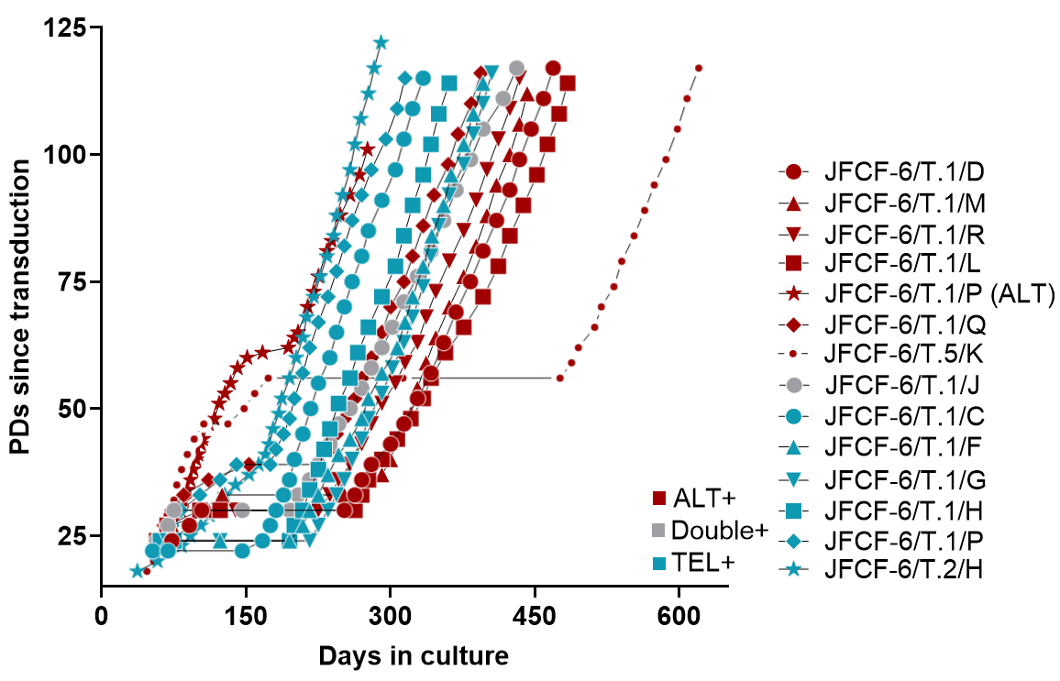
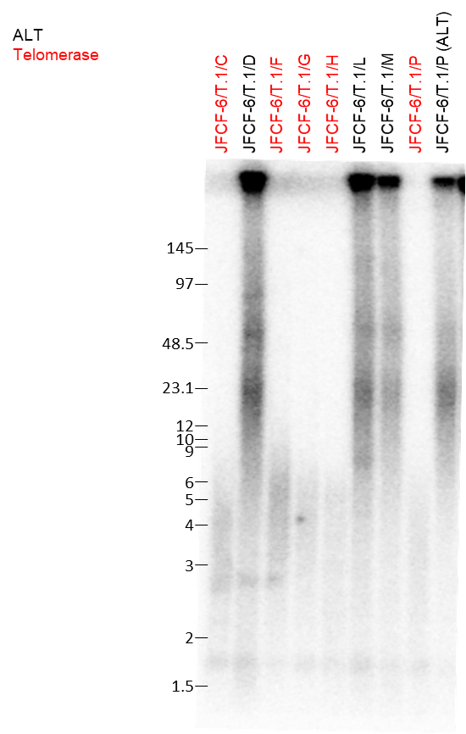
1. Immortalized cell lines with different TMMs established from the same origin
a
b
c
d
f
e

Slide 3
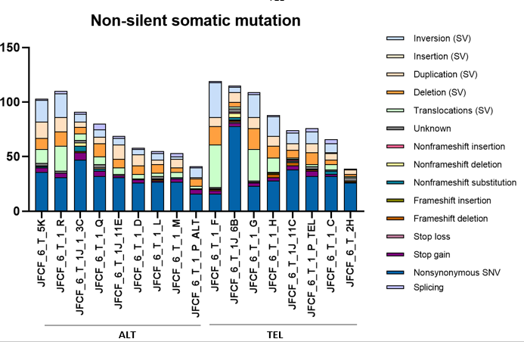
2. Similar levels of genome mutation and rearrangement in ALT/TEL cell lines
More data needs to be generated.
(will get some ideas from the meeting next Monday)

Slide 4
3. Loss of ATRX as a universal feature in ALT cells

Slide 5
3.1 Top mutations in ALT by Fisher Test (p < 0.2)
Gene | count_ALT | count_TEL | p_value
ATRX | 9 | 0 | 4.11E-05
LINC01193 | 6 | 1 | 0.036404772
LOC101929322 | 4 | 0 | 0.052941176
PRKXP1 | 4 | 0 | 0.052941176
SNAR | 5 | 1 | 0.088235294
VPS37A | 7 | 3 | 0.117030029
EBF1 | 3 | 0 | 0.123529412
LINC02073 | 3 | 0 | 0.123529412
NWD1 | 3 | 0 | 0.123529412
TMEM18 | 3 | 0 | 0.123529412
XKR4 | 3 | 0 | 0.123529412
DDX11L10 | 4 | 1 | 0.183257919
LOC440570 | 4 | 1 | 0.183257919
MBD6 | 4 | 1 | 0.183257919

Slide 6
3.2 Top mutations in TEL by Fisher Test (p < 0.1)
Gene | count_ALT | count_TEL | p_value
NUCKS1 | 0 | 4 | 0.029411765
PIK3R2 | 0 | 4 | 0.029411765
POLR2J2 | 0 | 4 | 0.029411765
UPK3BL1 | 0 | 4 | 0.029411765
BMS1P20 | 1 | 5 | 0.042986425
NBPF20 | 1 | 5 | 0.042986425
AMER2 | 0 | 3 | 0.082352941
CHL1 | 0 | 3 | 0.082352941
CSMD3 | 0 | 3 | 0.082352941
GOLGA6L3 | 0 | 3 | 0.082352941
KCNH5 | 0 | 3 | 0.082352941
LINC01665 | 0 | 3 | 0.082352941
LOC100132077 | 0 | 3 | 0.082352941
LOC729683 | 0 | 3 | 0.082352941
MYO9B | 0 | 3 | 0.082352941
ROCK1P1 | 0 | 3 | 0.082352941
WHAMMP2 | 0 | 3 | 0.082352941

Slide 7
3.3 Top signature for mutation combination
TCAM1P + TACC2 + LOC112267871 = ALT

Slide 8
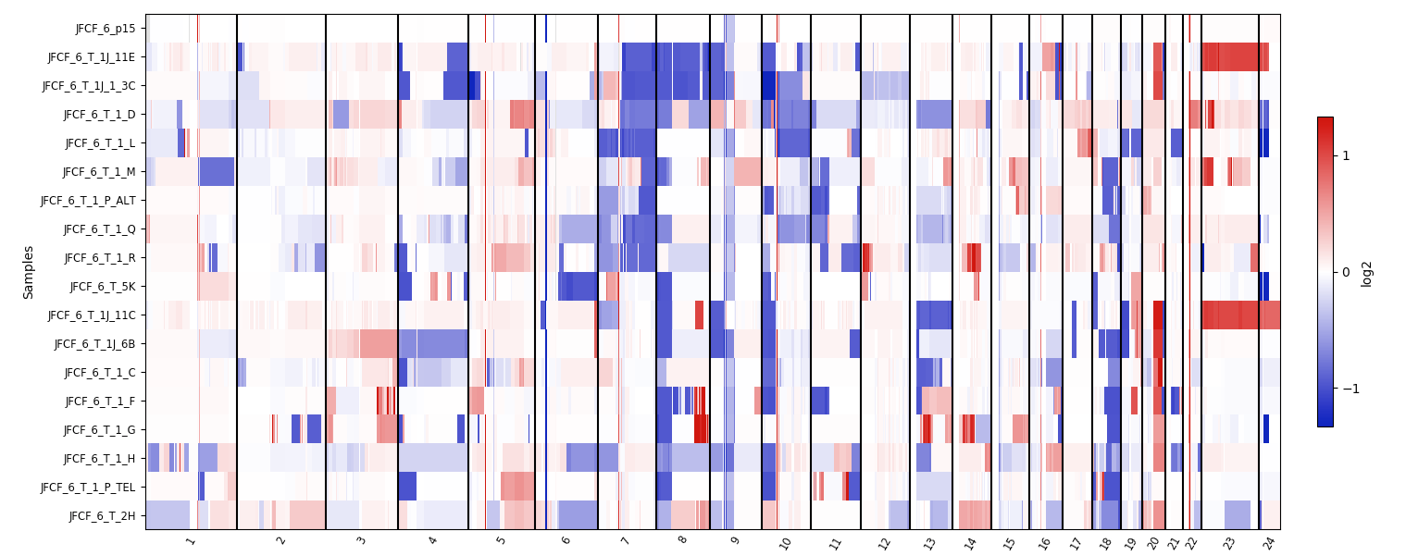
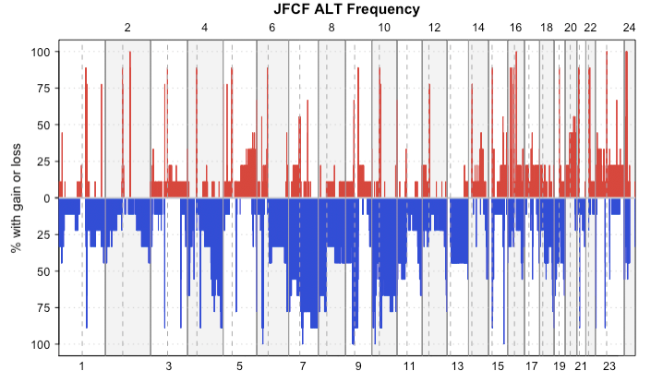
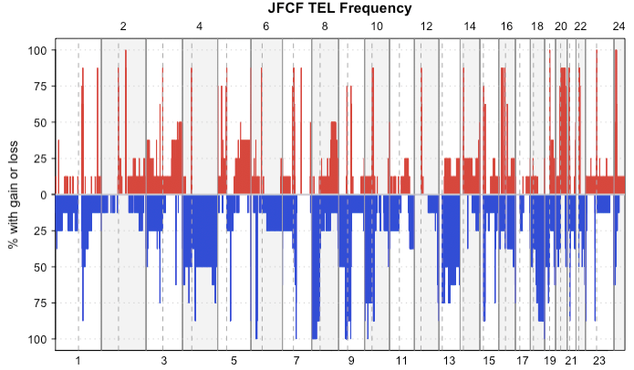
4. Loss of ATRX and 7q as significant features in ALT+ cells
parental
7q loss
ALT
TEL
b
c
Figure 3 Copy number analysis of JFCF-6 cell lines.
Notes:
Copy number analysis of JFCF-6 cell lines.
(a) WGS copy number results of JFCF-6 parental cell (P15) and immortalized cell lines. The colour in figure scales from blue (loss) to white(neutral) and to red (amplification). 7q is highlighted as most ALT cell present loss in this region while TEL cells do not. (b) (c) The frequency of copy number variance shown in ALT and TEL groups. Red colour indicates gain and blue colour demonstrates loss.

Slide 9
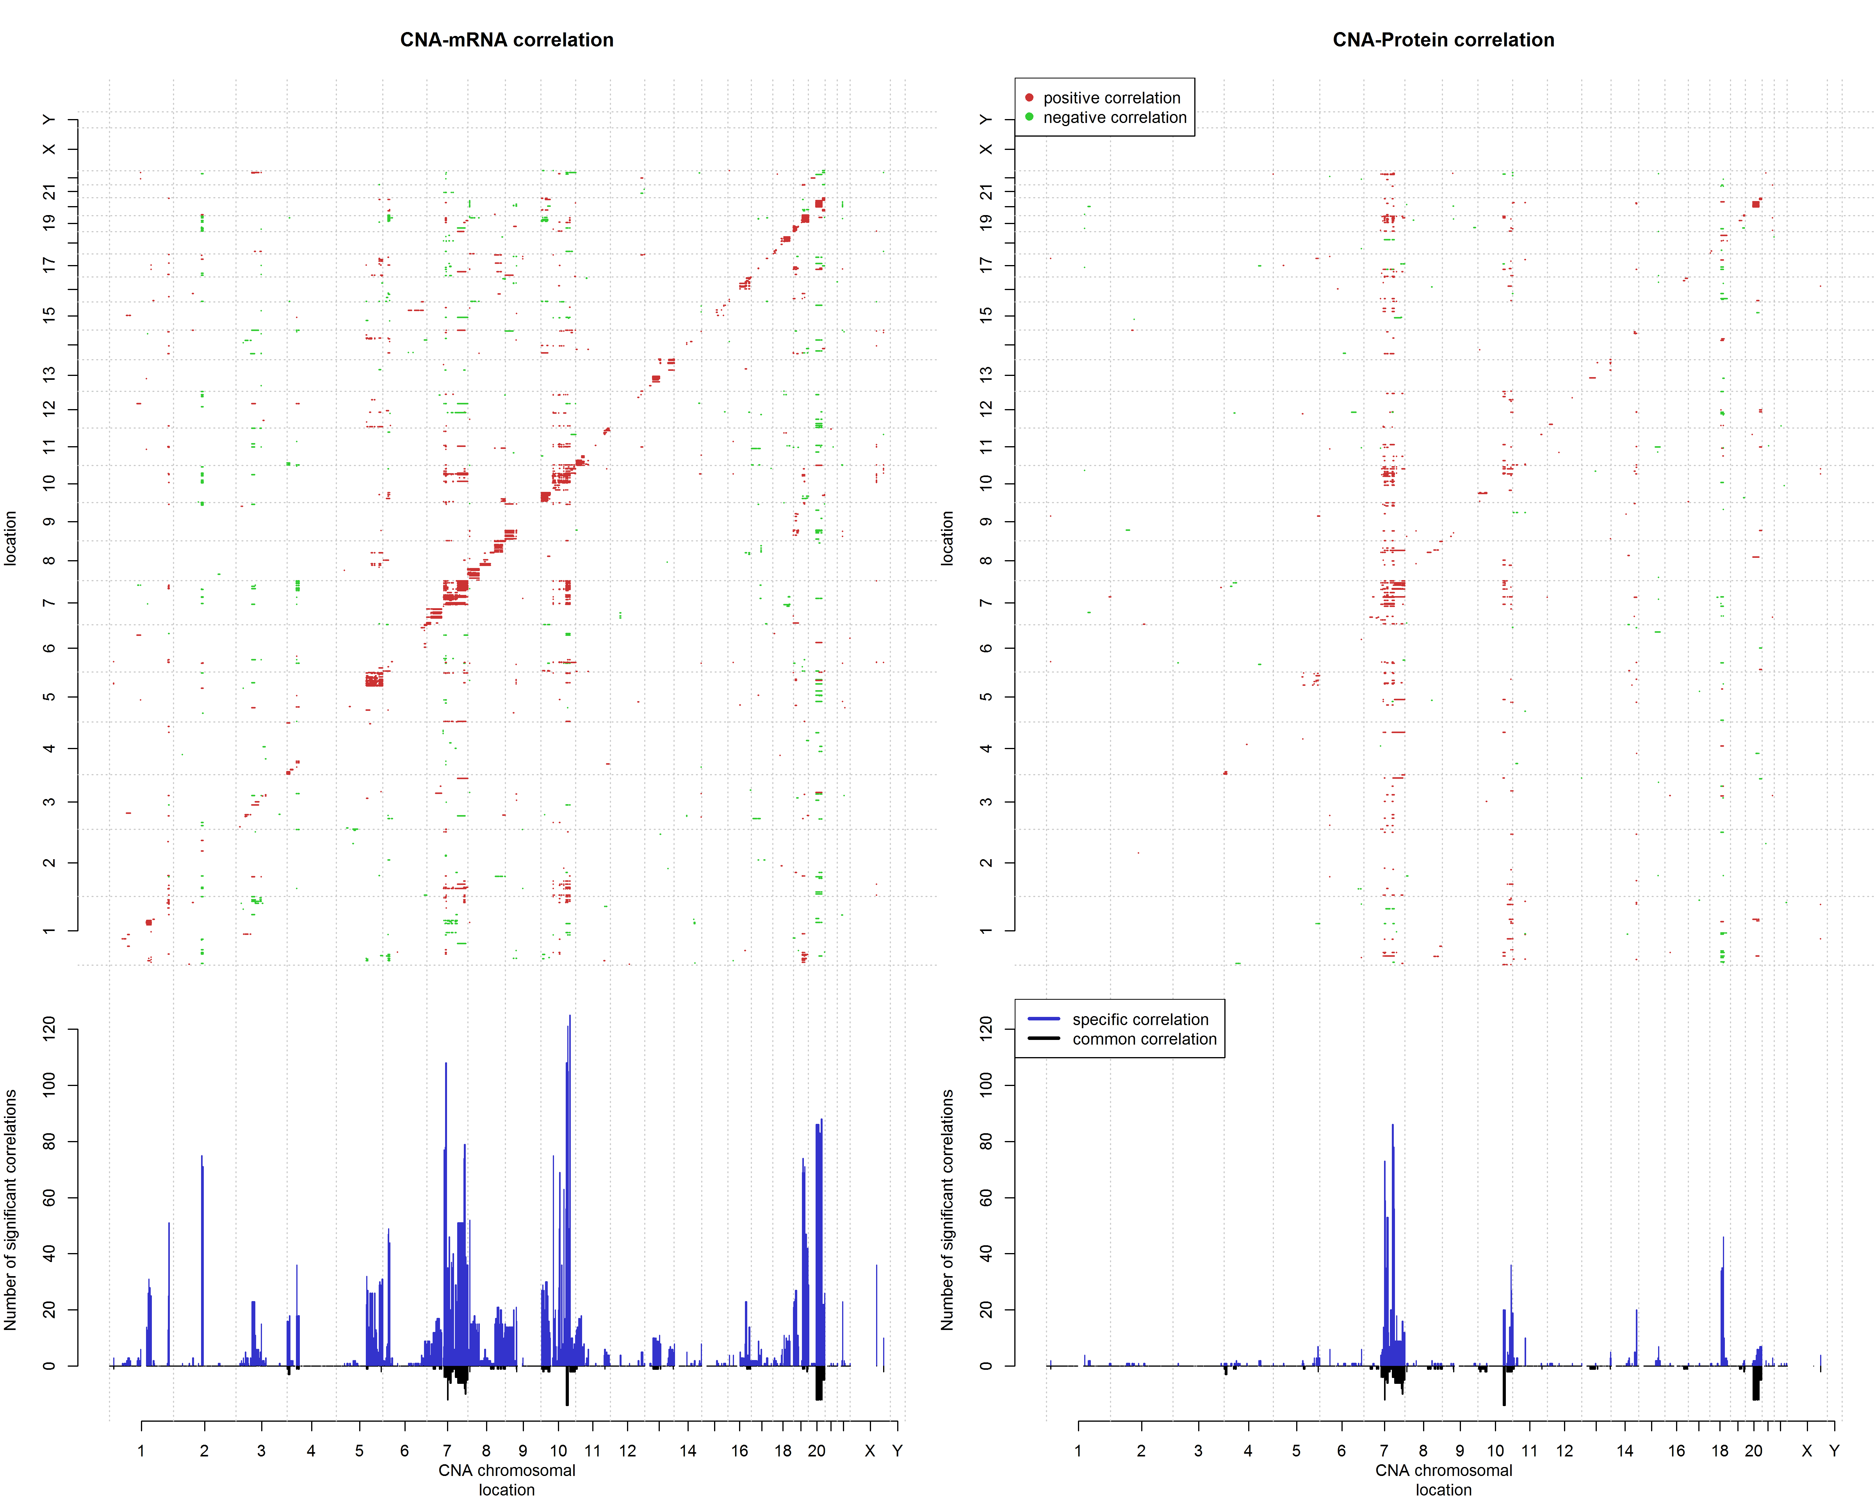
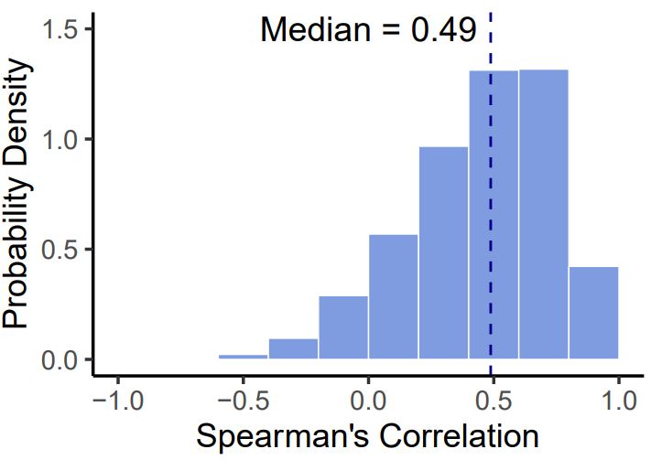
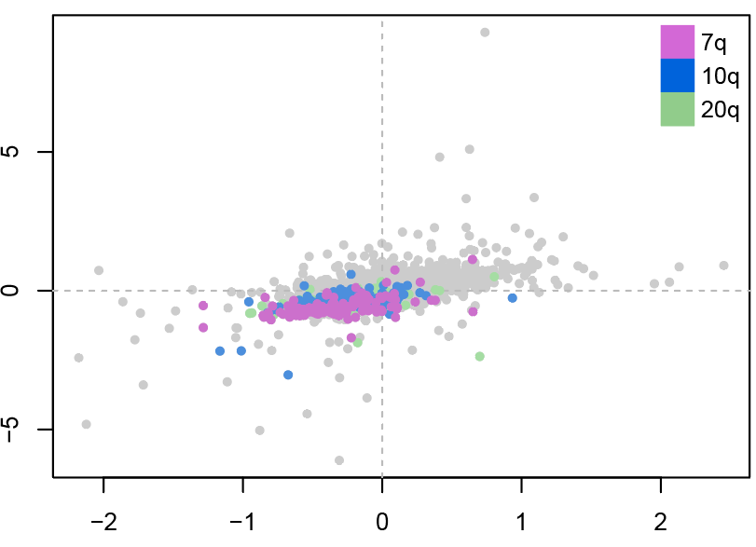
5. Positive associations of CNA on 7q,10q and 20q with gene expressions
a
b
c
RNA vs protein
RNA_log2(FC ALT vs TEL)
Protein_log2(FC ALT vs TEL)
Notes:
Impact of Copy Number abundance (CNA) on RNA and protein expressions.
(a) The upper panels present the correlation of copy number abundance ( x-axis) with RNA (right) and protein (left) expression levels ( y-axis) among JFCF-6 immortal cell lines. On both axis, genes are ordered based on location. Significant correlations ( Spearman correlation, BH adjusted p-value < 0.01) are highlighted in red (positive) and green (negative). The lower panels shows the number of significant correlations between CNV and RNA/protein. Blue bars shows the correlations specific to RNA or protein while the black bars indicate the common correlation in mRNA and protein. CNV on 7q, 10q and 20q show significant trans-affection on gene expressions. (b) Correlations of mRNA and protein expressions in JFCF-6 immortal cell lines ( Pearson correlation). (c) Scatter plots depict protein (x-axis) and RNA expressions (y-axis). Genes localized on 7q, 10q and 20q are highlighted in different colours.

Slide 10
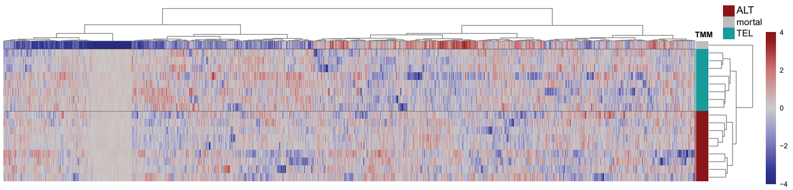
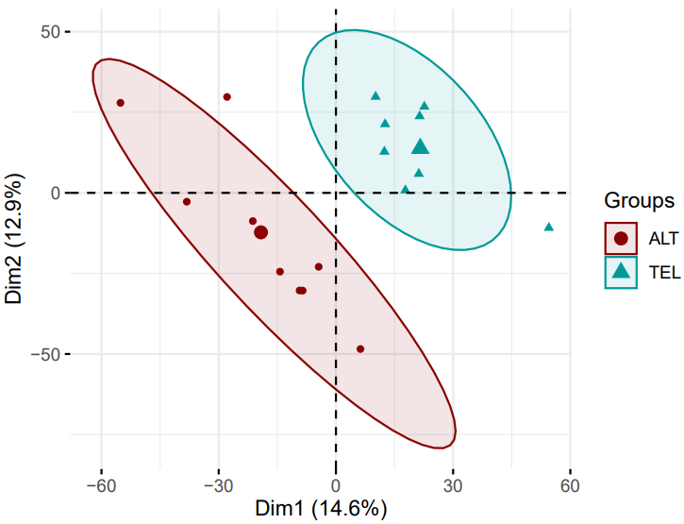
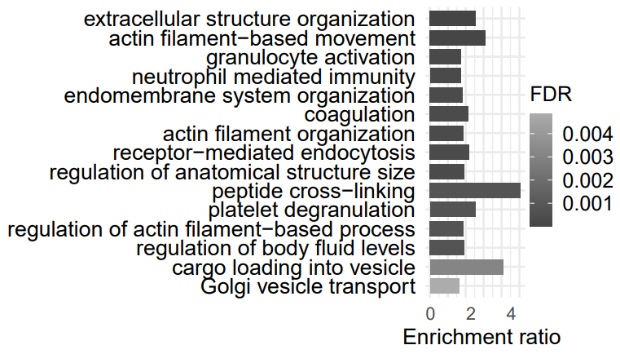
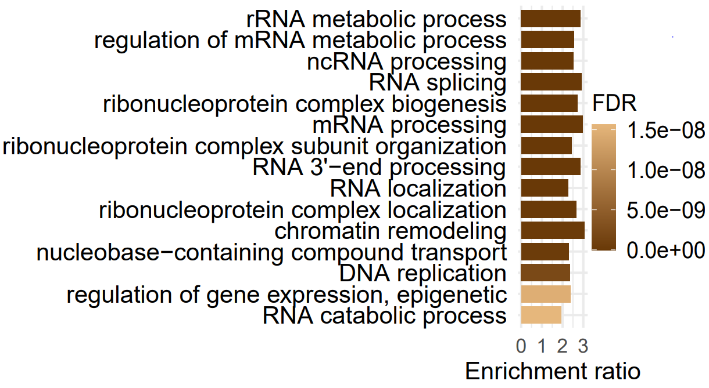
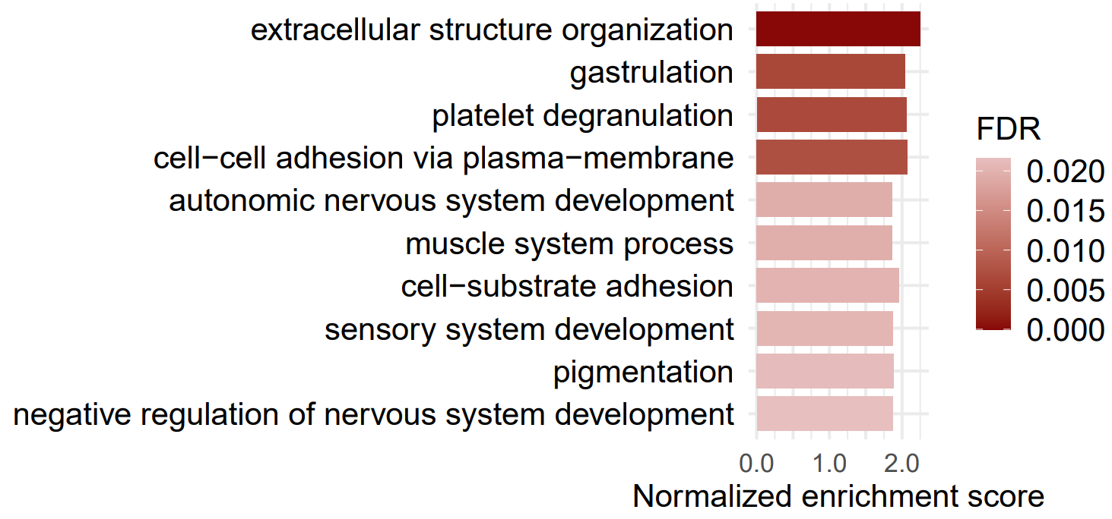
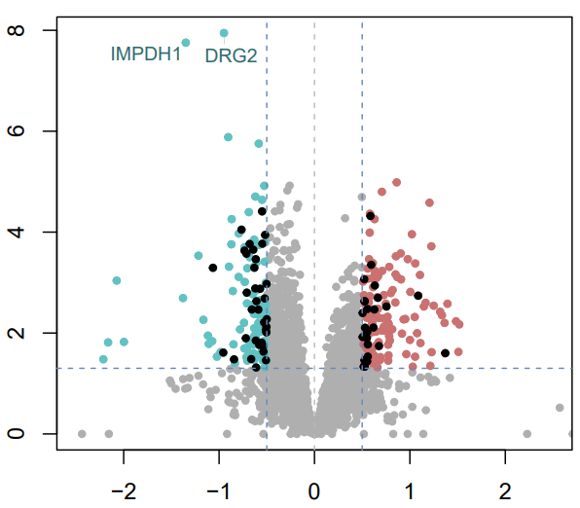
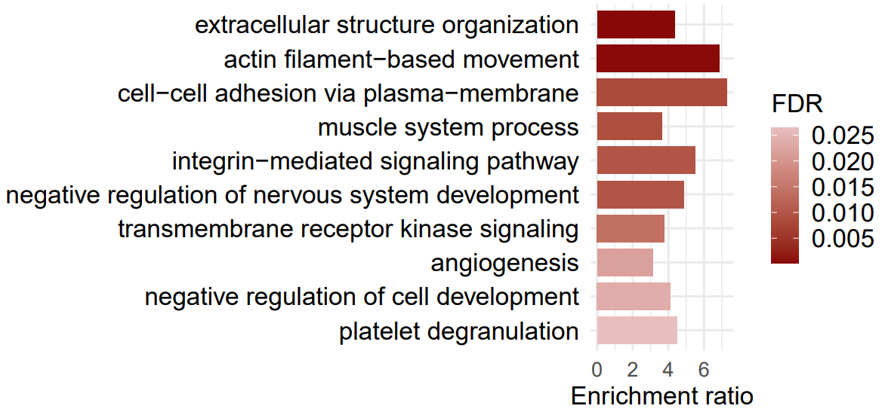
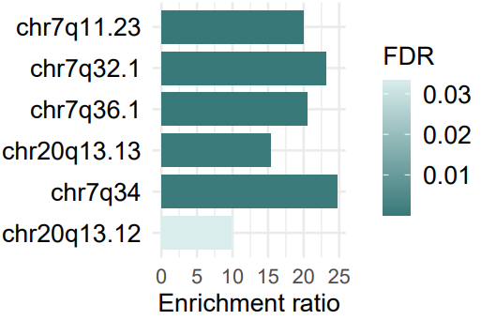
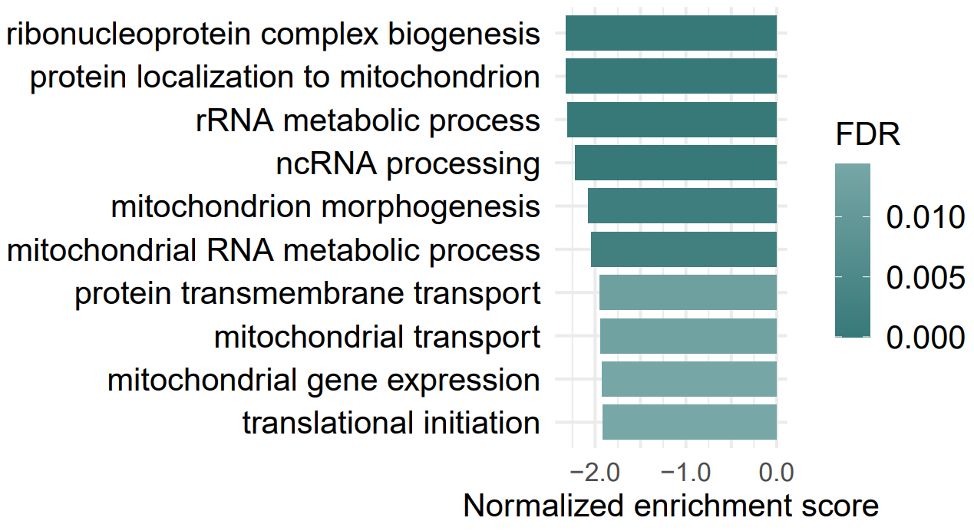
6. Quantitative proteomics present distinctions between parental, ALT and TEL cell lines
a
I
III
II
IV
V
VI
b
f
c
d
e
-log10(p-value)
g
log2 Fold change
Notes:
Quantitative proteomics of JFCF-6 cell lines
(a) Heat map of the 4,541 proteins from the quantitative proteomic data presents the unsupervised clustering of all JFCF-6 cell lines, showing distinctions between mortal, ALT and TEL cells. (b) Principal component analysis (PCA) of all proteins detected in JFCF-6 immortal cell lines shows the unsupervised clustering of ALT and TEL cells. (c) Volcano plot (log2-Fold change vs –log10(p-value)) shows the significantly differentially expressed proteins which were filtered using p-value < 0.05 and abs |log2(fold change)| >= 0.5. The proteins significantly upregulated in ALT cells are shown in red colour and the ones upregulated in TEL+ cells are highlighted in green. Black dots highlight the differentially expressed TM proteins. (d) Over representation enrichment results showing the top10 GO biological processes ( FDR < 0.01) of the genes significantly upregulated in ALT cells. The colour of bar indicates FDR significance and the x-axis presents the gene enrichment ratio of corresponding GO terms. For the proteins significantly upregulated in TEL cells, no GO terms pass the significance threshold ( FDR < 0.05). (e) Over representation analysis shows the top enriched chromosomal locations ( FDR < 0.05) of the genes significantly upregulated in TEL+ cells. For the genes significantly upregulated in ALT+ cell lines, there is no enriched chromosomal locations that pass the FDR significance cut-off (0.05). (f)(g) GSEA analysis shows the top10 GO terms of the genes upregulated in ALT+ (reds) and TEL+ (greens) cells separately. The colour scale of bars suggest the FDR significance and the x-axis shows the normalized enrichment score.

Slide 11
7. Proteogenomic model of immortalization process in JFCF-6 cells

Slide 12
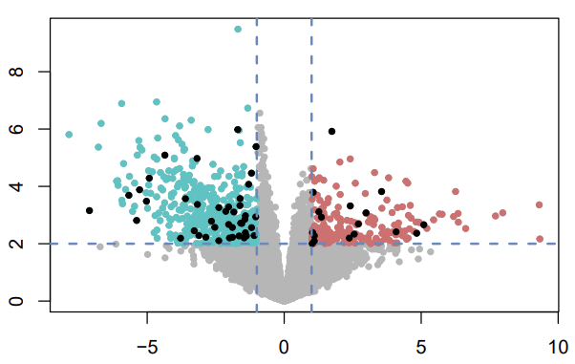
8. Identification of novel TM signatures
Top3 candidates to be verified
ALT vs TEL
ALT vs TEL
DRG2
-log10(p-value)
-log10(p-value)
IMPDH1
FGF1
log2 Fold change
log2 Fold change
RNA
RNA
FGF1 (5q31.3)
IMPDH1 (7q32.1)
DRG2 (17p11.2)
c
a
b
Protein
RNA
Protein
RNA
Protein
RNA
*IMPDH1 is on 7q
*For proteomic data, FGF1 just presents
expression in ALT cells
Verification experiments needs to be done

Slide 13
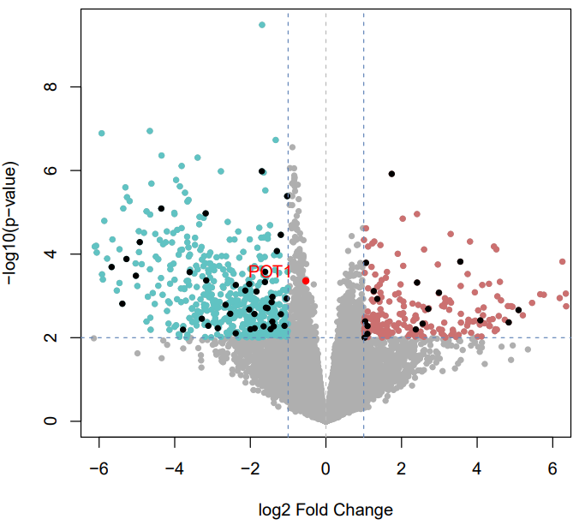
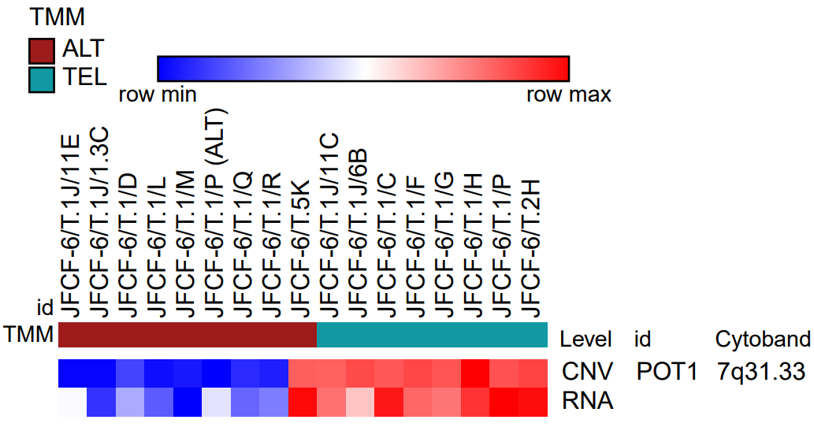
8. Identification of novel TM signatures
Another candidate worth trying
POT1
POT1(7q31.33)
RNA
POT1 is one of the six telomere binding proteins which are most essential for telomere biology
POT1 is on 7q
Verification experiments needs to be done

Slide 14
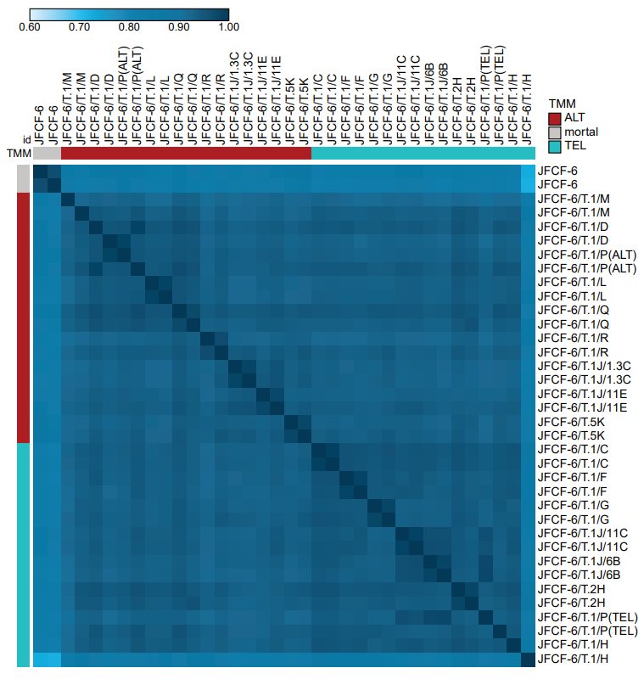
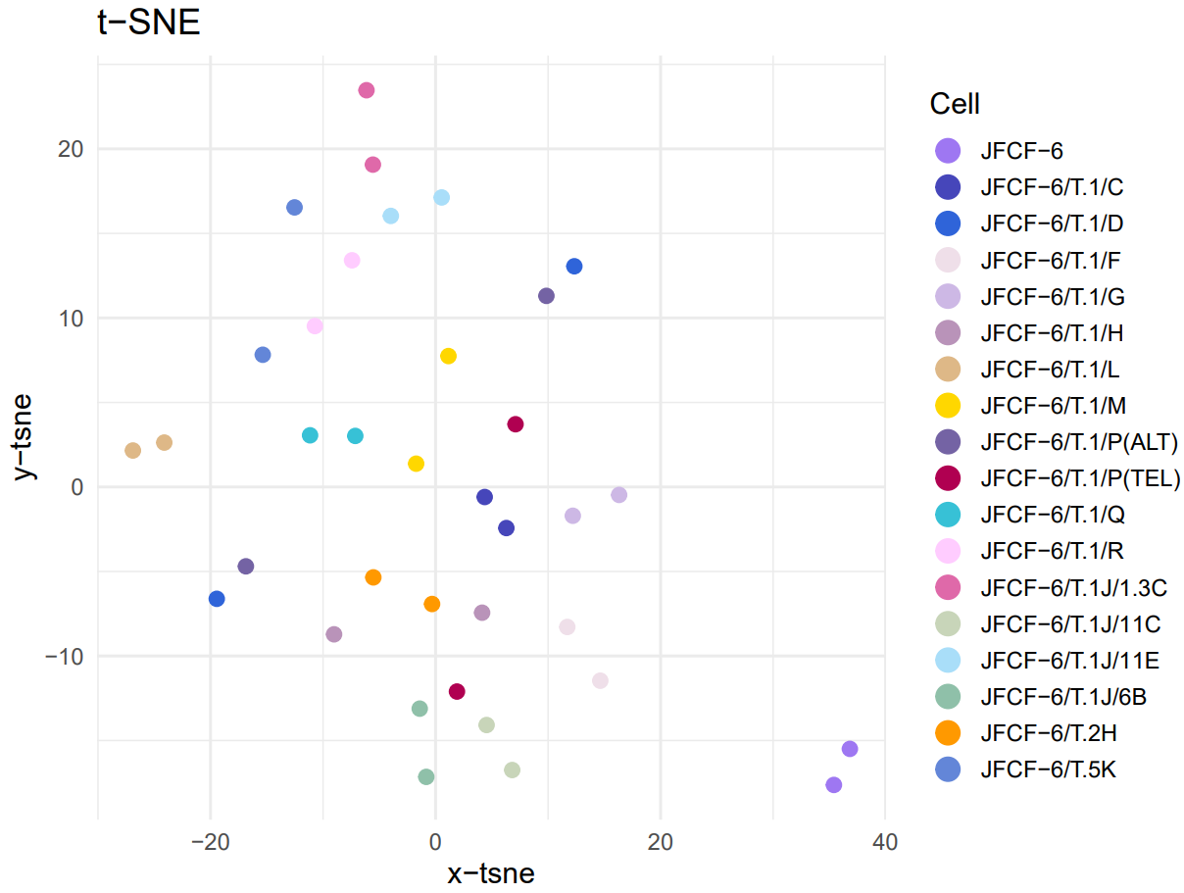
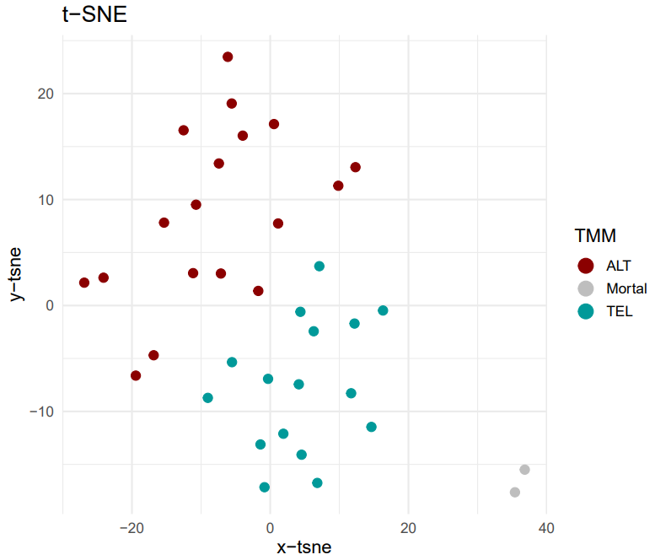
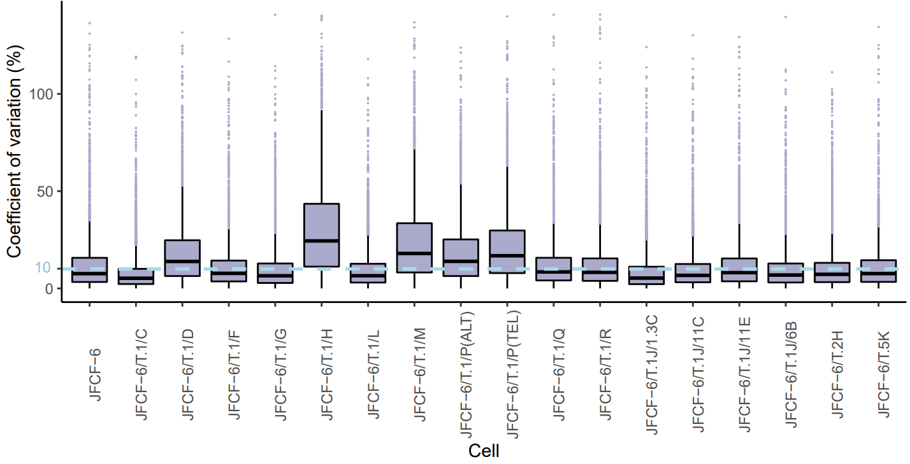
Supplementary data. Data QC
c
d
Proteomic
a
b
e
More QC results will be added later.
Proteomic and transcriptomic data looks pretty good. Not sure about genomic data QC, waiting for Simon.
Notes:
Proteomic data quality check results.
(a) t-sne plot of the JFCF-6 cell samples. Each cell line has biological replicates from independent cell cultures. Left figure show the clustering of replicates from the same cell line. Right shows the clustering of different cell groups. (b) Coefficient of variation of different cell lines. (c) Heatmap shows the Pearson correlations of JFCF-6 samples. (d) Dot plot shows the Pearson correlation R values of JFCF-6 replicate samples. The median value is 0.975 which was highlighted in the figure. (e) Missing rate of each cell line after the merge of biological replicates.

Slide 15
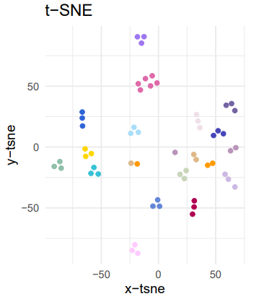
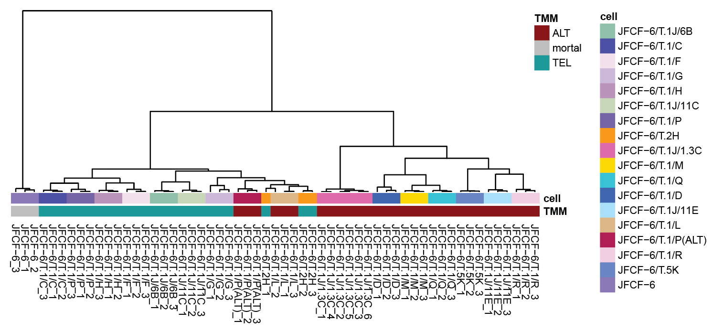
Supplementary data. Data QC
Transcriptomic
a
b
Notes:
(a) t-sne plot of the JFCF-6 cell samples. Each cell line has biological triplicates from independent cell cultures ( JFCF-6/T.1J/1.3C has six biological repeats). Different colors hight different cell lines. (b) Clustering map of JFCF-6 samples.

Slide 16
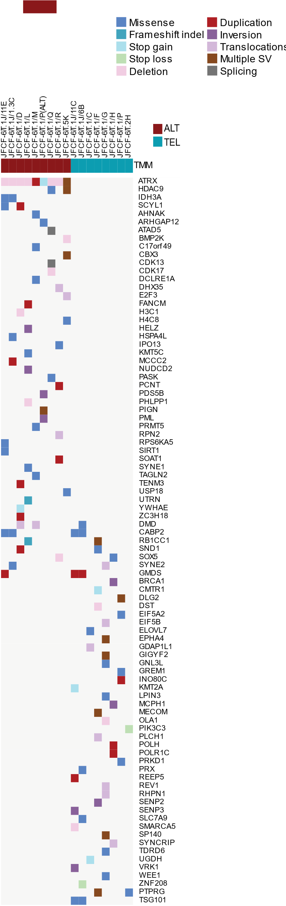
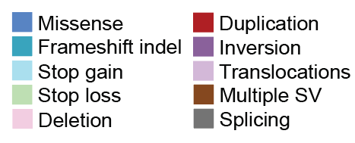
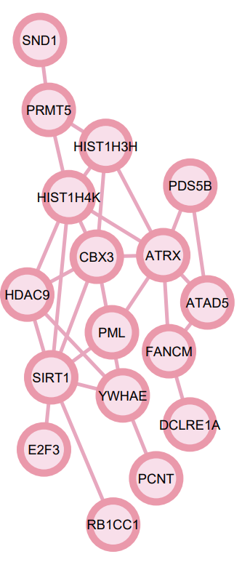
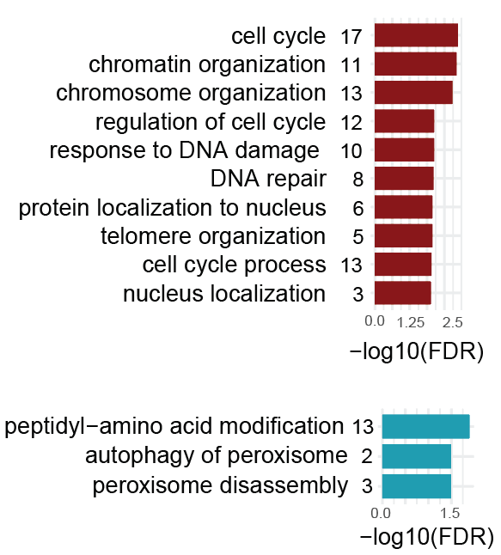
Supplementary data. Telomere maintenance relevant somatic mutations
a
TM relevant mutations
ALT
TEL
b
d
42 7 40
c
Enriched pathway
*
*
*
FDR <0.01
*
Notes:
Telomere maintenance relevant somatic mutations
(a) heatmap presents non-silent mutations in TM-associated genes which were filtered based on TelNet database. (b) Venn diagram displays the common and distinct numbers of mutated TM genes in different cell groups. (c) Top enriched pathways of mutated TM genes in ALT and TEL cell lines. This analysis was processed with Toppgene Suite. (d) Protein-protein interaction (PPI) network shows the genes involved in the top pathways labelled with * in (c). The PPI analysis was processed via STRING 11.0 with default settings and virtualized via Cytoscape.

Slide 17
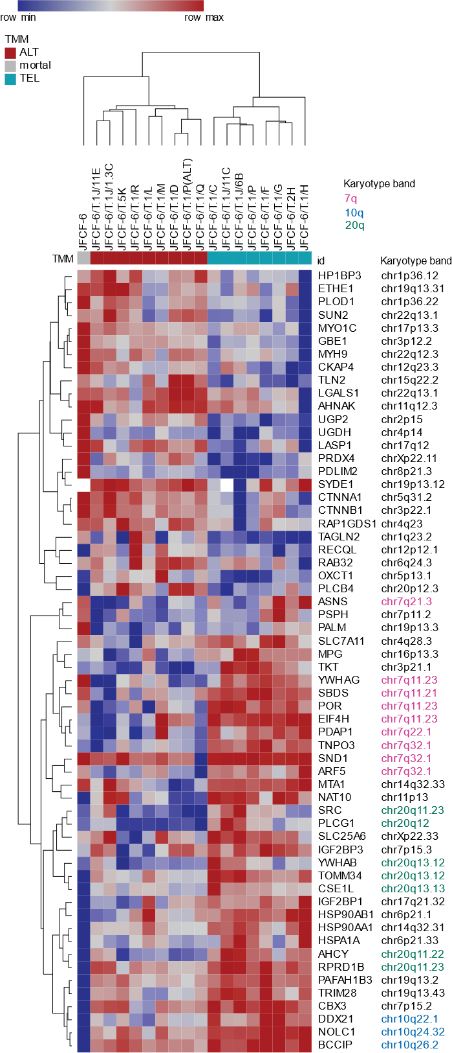
Supplementary data. Differentially expressed telomere maintenance proteins in ALT/TEL cells
-log10(p-value)
log2 Fold change

